Slide 1


Bayes’ theorem
By: Adib Un Nur
CS 131 Discrete Structures

Slide 2
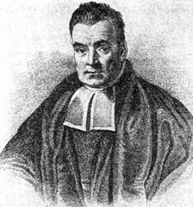
What is Bayes' theorem ?
Bayes Theorem is a method to determine conditional probabilities – that is, the probability of one event occurring given that another event has already occurred.

Slide 3

Background on theorem:
The theorem was discovered among the papers of the English Presbyterian minister and mathematician Thomas Bayes and published in 1763.
Bayes never published what would become his most famous accomplishment; his notes were edited and published posthumously by Richard Price.
Bayes' solution to a problem of inverse probability was presented in "An Essay towards solving a Problem in the Doctrine of Chances" which was read to the Royal Society in 1763 after Bayes' death.

Slide 4
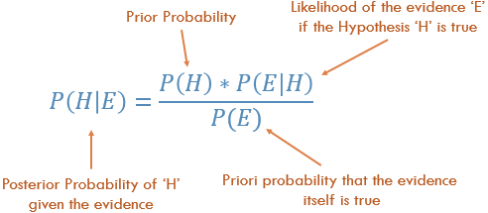
Bayes’ Theorem formula

Slide 5

Example:
To better understand the concept, lets imagine that someone goes to the doctor for their checkup, and they are not feeling well. After a lot of tests and examinations, the results show that they have a rare disease. The doctor also says there’s 1% chance that the test could be a false positive. If we ask people what is the chance for this person to have the disease, most will say 99% since that’s how accurate the test is. Well, it is not correct……..

Slide 6

Example (continued)
If we were to imagine 1000 people, and only one person has the same disease, the test would most likely identify them correctly. The test would also show that 10 people would be falsely identified with this disease out of the 999 people.
So, only 1 in 11 out of the thousand people would have this disease.

Slide 7

Example (final)
So, if the 1 person out of the 11 people test again and get another positive, then there’s a better chance that they really do have the rare disease.
Bayes’ Theorem is used to update the information and get a probability that will go up or down depending on the results of the theorem.
Bayes’ Theorem is used to constantly get closer and closer to a probability that will be more accurate the more data it is being fed.

Slide 8

Bayes Theorem in Machine Learning
Bayes Theorem is widely used in the field of machine learning. Including its use in a probability framework for fitting a model to a training dataset, referred to as maximum a posteriori or MAP for short.
Because a conditional probability includes additional conditions – in other words, more data – it can contribute to more accurate results.
This Photo by Unknown Author is licensed under CC BY

Slide 9

Advantages of Naïve Bayes Classifier in Machine Learning:
It is one of the simplest and effective methods for calculating the conditional probability and text classification problems.
A Naïve-Bayes classifier algorithm is better than all other models where assumption of independent predictors holds true.
It is easy to implement than other models.
It requires small amount of training data to estimate the test data which minimize the training time period.
It can be used for Binary as well as Multi-class Classifications.

Slide 10
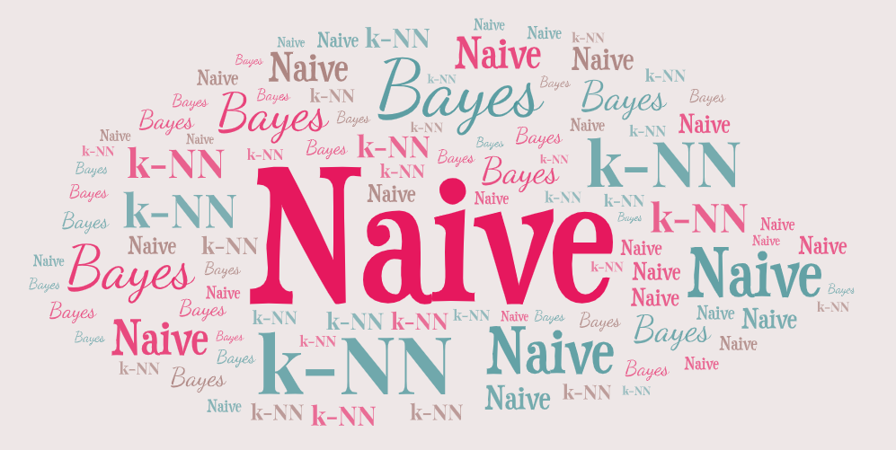
Disadvantages of Naïve Bayes Classifier in Machine Learning:
it limits the assumption of independent predictors because it implicitly assumes that all attributes are independent or unrelated but in real life it is not feasible to get mutually independent attributes.

Slide 11

Conclusion:
Bayes’ Theorem can be used in almost every situation that involves any kind of probability. And even though technology is constantly evolving, they are still following the classical theorems and algorithms. Bayes theorem has so many applications in Machine Learning. In classification related problems, it is one of the most preferred methods than all other algorithm. Machine Learning is highly dependent on Bayes theorem.

